Slide 1
Commerce Clause
The Constitutional Authority to Regulate Business
Commerce = all business dealings that affect more than one state
Substantial Effect Rule = Does the activity substantially effect interstate commerce?

Slide 2
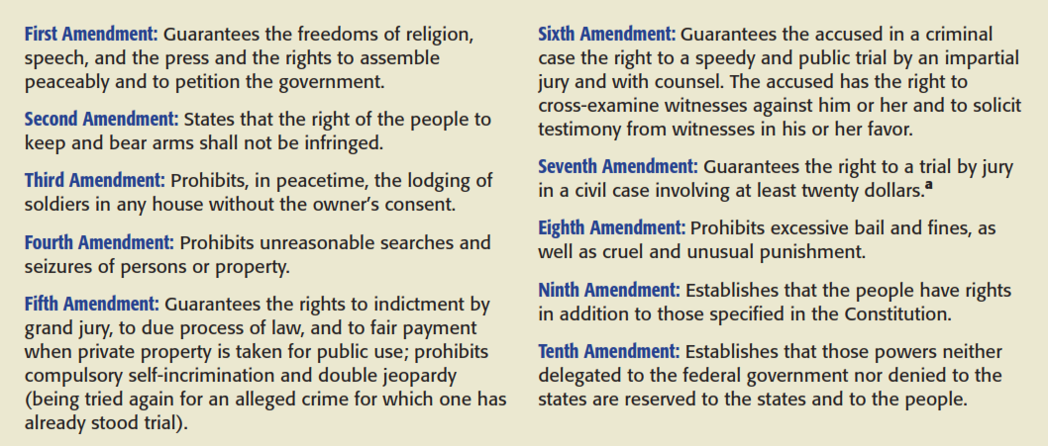
Fundamental Rights

Slide 3
Privacy Rights
    Not in the constitution. But derived from First, Fifth and Fourteenth Amendments.

Slide 4
Fifth Amendment:
Due Process
Fifth Amendments provides “no person shall be… deprived of life, liberty or property without due process of law; nor shall private property be taken for public use, without just compensation.”

Slide 5
Fifth Amendment:
Procedural Due Process
  Government must go through procedures to ensure the result is fair
  2 part analysis:
    Is the Government attempting to take liberty or property?
    If so, how much due process is due?

Slide 6
Fifth Amendment:
Substantive Due Process
Some rights are so fundamental that the government may not take them from us at all
** Fundamental Right – if government is trying to take away a fundamental right they must show a compelling state interest (Strict Scrutiny Test)

Slide 7
Fourteenth Amendment:
Equal Protection
  Similarly situated individuals must be treated in the same manner.
Equal Protection Tests
  Strict Scrutiny = Race, Ethnicity, and Fundamental Rights. - Is the classification necessary to promote a compelling state interest, and be narrowly tailored to further that interest.
  Intermediate Scrutiny = Gender - Is the classification substantially related to important governmental objectives
  Rational Basis = economic or social regulation – Is the classification related to ANY legitimate rational governmental interest.

Slide 8
Commercial Speech
(Advertising/Soliciting)
CENTRAL HUDSON TEST
A law or regulation limiting lawful and truthful commercial speech will be deemed constitutional (i.e. the government may regulate commercial speech) if the law or regulation:
1) seeks to implement a substantial governmental interest
2) directly advances that substantial governmental interest, and
3) goes no further than to accomplish that objective (i.e. it is narrowly tailored to accomplish the objective)

